Slide 1
MLPs, REITs and YieldCos for Renewables Webinar 2.0
Presented by: David K. Burton of Akin Gump
Amit Kalra of Winston & Strawn
Eli Katz of Chadbourne & Parke
September 4, 2014

Slide 2
Entities Taxed Only Once
The corporate income tax essentially taxes each dollar of earnings twice
  When earned by the corporate entity
  When paid as a dividend to shareholders (subject to reduced rates and exceptions)
Publicly traded entities strive to avoid the double-tax and increase after-tax returns to shareholders
  Congress has sanctioned certain “special” vehicles over time
    REITs
    MLPs
  Always limited to specific sectors and in the case of REITs a strict distribution ratio requirements
Sectors that are not lucky enough to have a single tax vehicle, may try to create a similar result by structuring operations to reduce taxes at the corporate entity level
  Interest deductions
  Depreciation deductions
  Tax credits

Slide 3
What is a YieldCo?
  Yieldcos are “wind- and solar-generation companies, which provide power under long term contracts and pay out much of their cash flow to shareholders, similar to an MLP. Without much regard to subtlety, bankers have been calling these new stocks ‘yieldcos.’”
  Matt Jarzemsky, Dividend-Paying Stocks Fit the Bill, Wall St. J., July 8, 2014, at C2.

Slide 4
YieldCo – I-Bankers’ Rules of Thumb
Investment bankers have rules of thumb for a YieldCo to be attractive to the public market:
  transaction needs to be of a sufficient size to merit the cost of the initial public offering (IPO)
  the on-going costs of being public entity (e.g., Sarbanes-Oxley compliance)
  roughly speaking, that means the YieldCo needs to be raising at least approximately $150 million or more in equity in the IPO
The market will demand consistent cash flows to pay distributions, so that means substantial EBITDA (i.e., earnings before interest, taxes, depreciation and amortization)
Sponsor should have skin in the game by retaining a substantial interest (i.e., more than 50%) in the projects that YieldCo will invest in
  Ensures the sponsor continues to maximize the operations of the assets, rather than using YieldCo as a means to cash out
So sponsor needs more than $300 million in project assets to support an IPO

Slide 5
YieldCo Example – NRG Yield, Inc.
NRG Energy
Public Shareholders
IPO raised $431 MM
60%
Class B Common Stock 70% Voting Interest
0% Economic
Interest
NRG Yield, Inc.
Class A Common Stock 30% Voting Interest
40%
NRG Yield
LLC
100%
NRG Yield Operating LLC
100%
49.95%
100%
49.95%
49.95%
100%
100%
100%
Gen
Conn
Marsh Landing
Avenal
CVSR
South Trent
Thermal
Other Utility Scale and Distributed Generation Solar Projects

Slide 6
NRG’s “YieldCo” Structure – Tax Treatment
NRG Yield Operating, LLC will not pay tax and rather will pass the tax attributes through to NRG Energy (60%) and NRG Yield LLC (40%)
  NRG Yield, LLC is a flow through to NRG Yield, Inc.
Cash distributions from NRG Yield, Inc. to the shareholders will be taxable dividends to the shareholders to the extent of NRG Yield, Inc.’s E&P
E&P is calculated like taxable income but (i) without tax credits, (ii) using straight-line depreciation over the class life of the asset (12 years for renewables) and (iii) with a deduction for income taxes paid
To the extent the cash distributions exceed NRG Yield, Inc.’s E&P, the distributions will reduce the shareholders’ basis in their shares of NRG Yield, Inc.
A lower basis means a larger gain when the shareholders sell their shares, which if the shares were held for more than a year, would be taxed at the 23.8% long term capital rate for individuals
To maximize its value, NRG Yield, Inc. will need to keep growing
  New assets with tax credits and depreciation are needed to shelter the taxable income generated by older assets that have exhausted their tax benefits
An average solar developer is not positioned to launch a yieldco, it may want to consider selling projects to a large company planning an IPO

Slide 7
NextEra Energy Partners, LP
Public Shareholder
NextEra Energy, Inc.
(“NextEra”)
100%
NextEra Energy
Management Partners, L.P.
(“NEE Management”)
100%
NextEra Energy Resources, LLC
(“NEER”)
LP Interest
100% Economic Interest
17.4% Voting Power
100%
NextEra Energy Partners GP, Inc.
(“our general partner”)
100%
100% GP Interest
0 % Economic Interest
NextEra Energy, Partners, LP*
NYSE: NEP
0% Economic Interest
82.6% Voting Power
Special Voting Units
100%
NextEra Energy
Equity Partners, LP
(“NEE Equity”)
76,877,500 Special Voting Units in NE Partners
76,877,500 Common Units of NEE Operating LP
NextEra Energy Operating
Partners GP, LLC
(“NEE Operating GP”)
LP Interest
17.4% % Economic Interest
17.4% Voting Power
LP Interest
82.6% Economic Interest
82.6% Voting Power
GP Interest
0% Economic Interest
NextEra Energy Operating
Partners, LP
(“NEE Operating LP”)
*NEP is a limited partnership for state law purposes but taxed as a corporation
100%
100%
Canadian
Project Entities
U.S. Project
Entities

Slide 8
Domestic Projects/Canadian Projects
Domestic Projects
100%
100%
100%
100%
100%
Elk City Wind, LLC
Northern Colorado Wind Energy, LLC
Perrin Ranch Wind, LLC
Tuscola Bay Wind, LLC
Genesis Solar, LLC
Canadian Projects
Canadian entities for U.S. tax purposes “flow through” to the U.S., so pay Canadian tax and U.S. tax but with foreign tax credit in the U.S. for Canadian taxes
100%
100%
100%
100%
100%
Conestogo
Wind, LP
Summerhaven Wind, LP
Varna
Wind, LP
Sombra
Solar, LP
Moore
Solar, LP

Slide 9
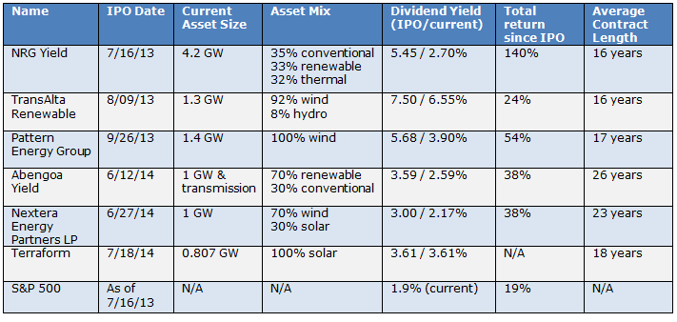
YieldCos Performance
Note: Current dividend yield and total return since IPO are both calculated from close on 7/17/2014.
Dividend yield calculations for stocks that have not yet issued dividends are based upon expected
dividend distributions.⁶
⁶ Kinrade, Thomas, A Sixth Yieldco Goes Public as the Asset Class Has its First Anniversary, http://www.solsystemscompany.com/blog/2014/07/18/a-sixth-yieldco-goes-public-as-the-asset-class-has-its-first-anniversary/.

Slide 10
MLP Overview
Formed to hold long-lived assets with stable income streams
  Largely fee based businesses in the natural resources sector
  Typically lower volatility / cyclicality
Key characteristics
  No corporate level taxation (in contrast to a YieldCo)
  Limited partnership is managed by a general partner (GP), which is typically owned by a financial sponsor
  Most of the operating cash flow of the partnership is distributed to unitholders
  Valuation primarily driven by cash flow profile of partnership
  Trade based on cash distribution yield expectations

Slide 11
Similarities and Differences for MLP Units and Common Corporate Stock
Similarities | Differences
Units are publicly traded (NYSE, NASDAQ, AMEX) Units represents ownership in the issuing entity, with growth opportunity Governed by board of directors with independent members | Unlike most corporations, a MLP typically distributes the majority of operating cash flow to its limited partners Partnership entity pays no tax (passes through to Investors) Tax law restricts ownership by mutual funds and retirement plans Investors receive K-1’s rather than 1099’s

Slide 12

Master Limited Partnership (MLP) – Current Law
An MLP is an entity that meets the exception to the rule that widely held partnerships, limited liability companies or trusts must be taxed as corporations
  MLPs are subject to the partnership rules of subchapter K of the Code
The requirement to be a MLP is that at least 90% of the entity’s gross income must come from “qualifying sources”
  Interest, dividends, and capital gains
  Rental income and capital gains from real estate
  Income and capital gains from natural resources activities
  Income from commodity investments¹
_______________
¹ I.R.C. § 7704(d)(1).

Slide 13
Master Limited Partnership (MLP) – Current Law
“Natural resource activities” include:
  Mining
  Refining
  Transport of petroleum, natural gas, coal and other minerals
The only renewable energy resources included as a “natural resource” are:
  Ethanol
  Biodiesel
  Geothermal
  Alternative fuels and industrial source carbon dioxide
Solar, wind and biomass activities do not generate “good” income for purposes of the 90% test

Slide 14
Relevant MLP Investment Classes
Buckeye
Enbridge
Enterprise
Genesis Energy
Holly
Kaneb
Kinder Morgan
Magellan
Pacific Energy
Plains
Sunoco Logistics
Transmontaigne
Valero
Fracking
Interest
&
DIvidends
Gas
Pipelines & Terminalling
NGL’s
Atlas
Copano
Crosstex
Enbridge
Energery Transfer
Enterprise
Hiland
Kinder Morgan
Crude Oil,
Refined Products
“Non-Qualified Income”
Most Electric Generation^{(c)}
Fortess
KKR
AmeriGas
Ferrellgas
Inergy
Suburban Propane
Retail
Propone
Highway Infrastructure
Master Limited Partnership
“MLP’s”
Marine
Logistics
Water
K-Sea Transportation
Martin Midstream
U.S. Shipping
Non-U.S.^{(a)}
Coal
Timber
Real
Estate
Other
Natural Resource Partners
Penn Virginia
More typically
held by REITs
(a) Certain minerals and natural resources must be located within the United States for MLP qualification. However, any non-qualifying assets could be housed under a foreign blocker corporation and become qualifying asset but raises foreign withholding tax issues.
(b) “Removal treatment, recycling and disposal of waste products from hydraulic fracturing” P.L.R. 2012270002.
(c) Income from selling electricty generated by geothermal energy is “qualified”.” Regulations proposed in 2014 would treat as qualified income from the sale of solar electricity to tenants of an adjacent building if the solar project and building have the same owner

Slide 15
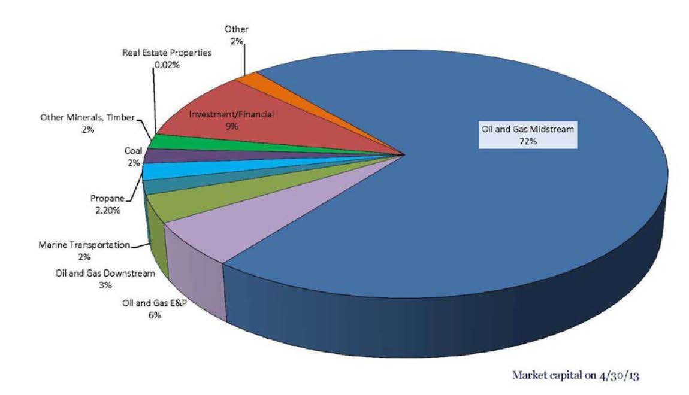
MLP Market Cap by Sector
Source: NAPTP (2013)

Slide 16

MLP Applicability to Renewables Today
A MLP could own land on which a renewable energy project is constructed and lease the land to the project
A MLP can likely own a building that it rents to tenants, and the MLP can install solar panels on the roof of the building and charge the tenants for the electricity that the panels supply
  However, most of the solar system’s capacity must be used to serve the building

Slide 17
MLP – Current Law – Renewables Structuring
10% Non-Qualifying Income
A MLP could try to fit renewables investment into the 10% of non-qualifying income it is permitted to realize
  The tax credits and depreciation from the renewable energy projects would flow through to the MLP’s partners (i.e., shareholders)
  Unless the partner is a widely held corporation, the tax benefits would be subject to the passive activity loss and at-risk rules that limit individuals’ ability to use losses and credits from such activities to offset income tax on their salaries or investment portfolio²
    The tax benefits could potentially be suspended until the earlier of when the partner exits the MLP or the MLP generates sufficient taxable income to use them
  The tax-exempt MLP partners (i.e., unit holders) cause complications for accelerated depreciation and investment tax credits for other parties to the transaction
_______________
² I.R.C. §§ 465, 469.

Slide 18
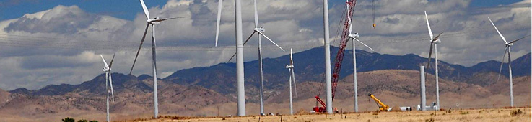
MLP – Current Law – Corporate Subsidiary
Alternatively, a MLP could form a taxable corporate subsidiary that owns, develops or operates renewable energy projects
  It could capitalize the corporate subsidiary with a combination of intercompany debt and an equity contribution
  All of the income the MLP would earn from the corporate subsidiary would be dividends and interest and thus “good” income for the MLP 90% test

Slide 19
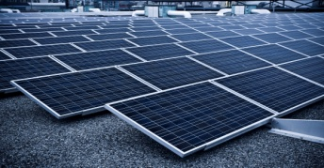

MLP Corporate Subsidiary Diagram
Management
Tax Cost
Public Unit Holders
MLP
(Publicly
Del. LLC Traded)
Principal + Interest on Intercompany Debt
Corporate Dividends
Taxable Subsidiary
Del. Corp.
Tax Cost after Tax Credits and 5 – Yr MACRS

Slide 20
MLP Corporate Subsidiary
MLP’s corporate subsidiary would have interest deductions from the intercompany loan and from the project’s accelerated depreciation and tax credits
At least for the five year depreciation period, the corporate subsidiary could shelter most or all of its income from tax. Beyond five years:
  The corporate subsidiary would either need to acquire new projects that generate more tax benefits
  Rely on unused tax credits and deductions from the initial projects, or
  Start paying tax
If the corporate subsidiary made distributions to the MLP, the unit holders in the MLP would have dividend income to the extent the corporate subsidiary had current or accumulated earnings and profits (E&P)

Slide 21
The Future for MLPs and Renewable Energy
The Union of Concerned Scientists estimated that MLPs would reduce cost of wind energy production by “1.2 cents per kwh, or about 40% of the value of the PTC”
  In 2012, First Wind estimated that MLPs would offer developers 25-30% of the benefits provided by PTCs ³
Senators Chris Coons (D-DE), Jerry Moran (R-KS), Sen. Portman (R-OH) and Lisa Murkowski (R-AK) are sponsoring a bill, the MLP Parity Act of 2013, to amend the MLP rules to make income from renewable energy projects “qualifying income”
  Bill would not enable MLPs to act as tax equity investors because it does not amend the “passive activity loss” rules or the “at-risk” rules
  MLPs under this legislation would only be efficient with respect to providing cash equity or debt to renewable energy projects (i.e., MLPs would not be tax equity investors)
  Jt. Committee on Taxation estimated that the bill would cost $307 million over 5 years and $1.3 billion over 10 years, a fraction of the $10.1 billion estimated cost for wind and solar tax credits over 5 years the J. Ct. estimated in 2012
If the bill were enacted, it would permit MLPs efficiently to raise capital to act as sponsors or developers
MLP could then partner with tax equity investors to execute transactions that raise cash for the MLP and provide the tax equity investor with a stream of tax benefits and cash flow
_______________
³ http://blog.ucsusa.org/master-limited-partnerships-mlps-lower-the-cost-of-renewable-energy-projects-512; http://www.mw-cleantechcapital.com/files/2013/11/BNA-Tax-Report.pdf; Copley, Michael, Questions linger over value of renewable energy MLP, SNL Energy(August 30, 2013).

Slide 22
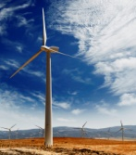
MLP With Tax Equity Investor if MLP Parity Act is Enacted
Management
Public Unit Holders*
MLP
Tax Equity Investor
Del. Corp.
Del. LLC
PTC
“Flip Partnership”
Analogizing Rev. Proc. 2007-65
Del. LLC
*An ITC deal would present “recapture” problems for unit holders that sold in first 5 –yrs but the recapture amount would be de minimis

Slide 23
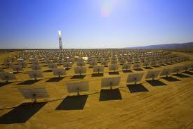

MLP Legislative Change – Improve Secondary Market for Renewables Projects
MLPs could purchase existing projects that had already generated their tax credits for their original owner
  For investment tax credit projects, this would be after the five-year recapture period
  For production tax credit projects, it would be after the ten-year credit period

Slide 24
MLP Legislative Change – Technical Issues
Equipment Leasing is not Covered
  The MLP bill does not include income from leasing renewable energy equipment to count as “qualifying income”
    Big issue for residential solar where the typical transaction is a lease
  SEIA may lobby to have this fixed
If the MLP had “tax-exempt” partners (i.e., shareholders), and the typical structure of incentive profits sharing with management (i.e., not a “straight-up” partnership), it would raise certain complexities for the tax equity investor’s eligibility to utilize fully accelerated depreciation and investment tax credits⁴
  The structure above assumes any tax-exempt and any foreign partners of the MLP hold their interests through a domestic corporation
  With respect to the tax-exempt partners, the domestic corporation must elect to treat any dividends, interest or gain earned by the tax-exempt partners as “unrelated business taxable income.”⁵
_______________
⁴ §§ 50(b)(4)(A), 168(h)(6).
  ⁵ § 168(h)(6)(F)(ii) (See possible exception in §168 (h)(6)(F)(iii)(I))

Slide 25
REIT Overview
Real Estate Investment Trust (“REIT”)
Can be publicly traded or closely held
Vehicle to raise public equity with a single layer of tax
Taxed generally as a C-corporation but gets a tax deduction for paying dividends to its shareholders
Under detailed tests described below, most of assets must be real estate or mortgages secured by real estate
Must dividend 90% of its taxable income

Slide 26
IRS’s Expansion of REIT Asset Classes
2014 proposed regulations approve a REIT owned solar project that provides substantially all its power to a building owned by the same REIT.
PLR approves solar panels mounted on cell towers that only serves the cell tower
RR approves
definition of real
property to include
railroad assets
RR approves
mobile homes
PLR
approves
timber
REITs
RR approves electric transmission & distribution assets, and data center
PLR approves
environmental
intangibles, cell
towers, outdoor
signs
2014 Proposed Regulations approves a REIT owned solar project that provides substantially all its power to a building owned by the same REIT.
1960
1969
1970
1971
1975
1988
1999
2007
2009
2011
2012
2013
REITs are created –
mostly “mortgage REITs”
First “Healthcare REIT” created –
must lease assets to a third party operator
RR
approves
microwave
towers
PLR
approves
cold
storage
PLR approves
natural gas
distribution
center
PLR approves
roof mounted
antenna &
offshore oil &
gas platform
Sources: Feldman et al. (2012), and NAREIT (2013)

Slide 27


2014: Proposed REIT Regulations for Solar
On May 12 Treasury introduced proposed regulations for solar REITs a few hours after President Obama’s speech on renewable energy
The fact pattern based the proposed regulations is very narrow
Regulations not effective until finalized
Unless business models change, the solar REIT regulations will apply to very few transactions
REIT
Payments for Electricity
Rent $
Electricity
Solar Project
REIT must own Solar Project and the Building its serving
Building
Prop. Reg. § 1.856-3(g), Ex. 9

Slide 28
REIT Investment in Renewables Under Existing Tax Requirements
As a general matter, a REIT can invest in renewables to the extent the income from renewables will not result in a failure of the percentage tests below
No real appetite for use for tax credits and accelerated depreciation renewables investments generate because a REIT is entitled to a tax deduction for merely paying dividends and must dividend 90% of its taxable income.
ITC reduced pro rata by the percentage of the REIT’s income that it distributed as a dividend
A REIT’s solar activities generate “good” income in limited circumstances
  REIT could own land on which a renewable energy project is constructed and lease the land to the project
  Second, a REIT could own a building that it rents to tenants, and the REIT can install solar panels on the roof of the building and charge the tenants for the electricity that the panels supply. The solar system may only supply electricity to the building (i.e., the electricity may not be sold into the grid)
  Third, a REIT could own mobile phone towers and install solar panels on the tower and charge the mobile phone companies that use the tower for the electricity the panels provide
    The panels can only provide electricity to the mobile phone equipment on the tower, and the location of the tower must be such that the grid is either not accessible or unreliable

Slide 29
REIT Tax Requirements
A REIT must invest 75 percent of its assets in qualifying assets which, generally means real estate or mortgages secured by real estate
At least 75 percent of its gross income must be “rents” from real property, interest on mortgages secured by real property, gains from sales of real property, or dividends or gain from other REITs
At least 95 percent of its gross income must be from rents from real property, interest, gains or dividends
  The definitions of eligible income are less real estate focused under the 95 percent test
  To be eligible rental income under either the 75 percent or 95 percent requirement, the lease must be a true lease (i.e., not in substance a debt financing), “hell or high water” and the lessee must be unrelated to the REIT
It must distribute 90 percent of its taxable income to its shareholders
It receives a tax deduction for that distribution

Slide 30

David K. Burton, Partner
New York
T +1 212.872.1068 F +1 212.872.1002 dburton@akingump.com
David K. Burton advises clients on a wide range of U.S. tax matters, with a particular emphasis on project finance and energy transactions. In addition, he also advises clients on tax matters regarding the formation and structuring of domestic and offshore investment funds.
Practice & Background
Mr. Burton has extensive experience structuring tax-driven vehicles, such as sale-leasebacks, flip partnerships, inverted leases and other structures, for the acquisition and financing of renewable energy assets.
Prior to joining Akin Gump, Mr. Burton was the managing director and senior tax counsel at GE Energy Financial Services (GE EFS), one of the world’s leading investors in energy projects. At GE EFS, Mr. Burton oversaw all of the tax aspects for over $21 billion in global energy projects from structuring transactions to accounting for taxes to formulating tax policy initiatives. During his tenure at GE EFS, the division’s investments in wind, solar, hydro, biomass and geothermal power grew to $6 billion, making GE EFS the largest tax-advantaged energy investor in the U.S. Before joining GE EFS, Mr. Burton was a tax lawyer at GE Capital and primarily focused on aircraft and equipment leasing and financing and asset acquisitions. From 1996-2000, Mr. Burton was a tax lawyer at a large, international law firm in Philadelphia.
Mr. Burton received his B.A. magna cum laude from Ithaca College in 1993 and his J.D. cum laude from the Georgetown University Law Center in 1996, where he was on the staff of The Tax Lawyer.
Areas of Experience
  Global Project Finance
  Tax
  Renewable Energy
  Real Estate and Infrastructure Funds
  Investment Management and Transactional Tax
  Private Equity Transactions
  Solar
  Wind
  International Tax
Education
J.D., Georgetown University Law Center, cum laude, 1996
B.A., Ithaca College, magna cum laude, 1993
Bar Admissions
New Jersey
New York
Pennsylvania
Court Admissions
U.S. Tax Court
U.S.D.C., District of New Jersey

Slide 31
David K. Burton, Partner
New York
T +1 212.872.1068 F +1 212.872.1002 dburton@akingump.com
Representative Matters
Mr. Burton’s recent representations include:
  advising Hunt Investment Management LLC on the formation of a fund to invest in U.S. renewable energy projects
  representation of a publicly traded company in the acquisition of an entity holding a $107 million portfolio of land and payments from land leases underlying wind and solar projects, including more than 7,500 acres of land leased to three solar projects with a value of approximately $60 million and the payments from 11 additional land leases for a portfolio of wind projects with a value of approximately $27 million
  advising a private solar developer in connection with $50 million acquisition and construction equity financing from a European based private equity firm for the pipeline of development and acquisition solar projects in the Western U.S. The capital stack for these projects will include special state-level incentives. (ongoing)
  acting as special tax counsel to NRG Energy and its California Valley Solar Ranch (CVSR) project in connection with inclusion of CVSR in NRG’s public offering of securities in Yieldco
  acting as project counsel for Treasury Grant and tax matters in the financing of California Valley Solar Ranch, a $1.5B solar PV project supported by a Department of Energy loan guaranty

Slide 32
David K. Burton, Partner
New York
T +1 212.872.1068 F +1 212.872.1002 dburton@akingump.com
Representative Matters
Mr. Burton’s recent representations include:
  representation of OneRoof Energy Group, Inc. in an IPO/reverse merger transaction pursuant to which OneRoof Energy, Inc., a national residential solar company, became a wholly owned subsidiary of a publicly traded company
  advising OneRoof Energy in a $50 million subscription receipts financing
  advising a high net worth individual on acquisition and financing of solar projects subject to virtual net metering in which the individual will materially participate in the operations to treat the tax benefits as active
  representation of State Street Bank & Trust in connection with the $260 million in tax equity financing for the Buffalo Dunes, a 250 MW wind project in Kansas backed by subsidiaries of Enel Green Power and GE Capital
  representing SunPower in connection with a sale and leaseback of photovoltaic solar energy equipment to be installed in California

Slide 33


